Slide 1

“Sparsifying Neural Networks Using Iterative Magnitude Algorithm”
Tribhuvan University
Department of Computer Science and Information Technology
Kirtipur, Kathmandu, Nepal
Presented By
Dipesh Neupane (15/079)
MSc.CSIT 2nd Semester
Supervisor: Asst. Prof. Bikash Balami

Slide 2
Contents
Introduction
Problem Statement
Background Study & Literature Review
Methodology
Conclusion
References

Slide 3
Introduction
Neural Networks are dense layered graph structures.
They are universal approximators of nonlinear functions and are optimized by some non-convex optimization algorithm.
But the networks are dense, and not all parameters might be necessary for approximation of the function.
So, sparsifying the networks using some pruning algorithm like the iterative magnitude algorithm[1] might be useful.

Slide 4
Problem Statement & Objectives
Problem Statement
Pruning networks is the process of removing unnecessary weights while keeping the accuracy of the model relatively the same.
One of the method for pruning a neural network is Iterative magnitude Pruning.
So, utilizing this algorithm to remove unnecessary weights from the neural network trained on MNIST dataset can be done.
Objectives
To introduce Lottery Ticket Hypothesis.
To prune a neural network using Iterative Magnitude Pruning.

Slide 5

Background Study and Literature Review
Background Study
Unstructured Pruning
Various tools have been used to sparsify networks since the early 1990s [2].
One of the pruning methods is unstructured pruning where weights are pruned in a more irregular fashion. And it can be defined as the following constrained optimization problem [3]:
where, w = w_0, w_1, …, w_K, m = binary mask and D = (x_i, y_i) is the dataset.
So, the problem is to find the appropriate mask m such that the accuracy of the model is same as the dense network.

Slide 6
Background Study and Literature Review…
Lottery Ticket Hypothesis:
Frankle et al. stated the Lottery Ticket Hypothesis in their [1] paper that: A randomly-initialized, dense neural network contains a subnetwork that is initialized such that – when trained in isolation–it can match the test accuracy of the original network after training for at most the same number of iterations.
Formally, we can define the network as f(x;w) with initial parameters w = w_0 〜 D_w. When optimizing with stochastic gradient descent (SGD) on a training set, f reaches minimum validation loss ℓ at iteration j with test accuracy a . In addition, consider training f (x; m ⊙ w) with a mask m ∈ {0, 1}^|w| on its parameters such that its initialization is m ⊙ w. When optimizing with SGD on the same training set (with m fixed), f reaches minimum validation loss l′ at iteration j′ with test accuracy a′. The lottery ticket hypothesis predicts that ∃m for which j′ ≤ j, a′ ≥ a, and ∥m∥_0 ≪ |w|.

Slide 7
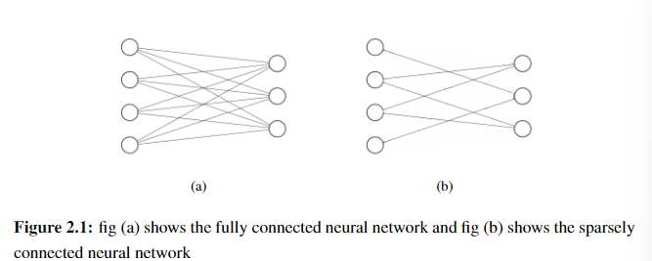

Slide 8
Background Study and Literature Review…
Iterative Magnitude Pruning Algorithm
To identify the winning tickets (as they are called in the [1]), following algorithm is introduced by Frankle et al.:
Randomly initialize a neural network f (x; w_0)
Train the network for j iterations, arriving at parameters wj.
Prune p% of the parameters in wj, creating a mask m.
Reset the remaining parameters to their values in w_0, creating the winning ticket f (x; w_0).
Repeat from 1.

Slide 9
Background Study and Literature Review…
Literature Review
Frankle et al. [1] stated the lottery ticket hypothesis and described the iterative magnitude pruning algorithm in their paper. Their method were able to train pruned AlexNet and ResNet architecture with high accuracies.
LeCun et al. [2] put forward the idea of weight decay to prune unnecessary weights and showed that it would improve generalization by suppressing the effect of noise on the targets.
Han et al. [4] showed their algorithm consisting of learning only important connections, quantizing the weights and finally applying Huffman coding to prune and store the network which was as 35x smaller than the original network.
Savarese et al. [5] provided a method for sparsification with ℓ0 regularization. Although, ℓ_0 regularization have intractable solution, an approximation method was introduced to solve the problem.
Diffenderfer et al. [6] showed a theoretical proof of existence of quantized subnetwork that can have similar test accuracies with the original network.Along with that, a new algorithm was proposed which found out quantized subnetworks.

Slide 10
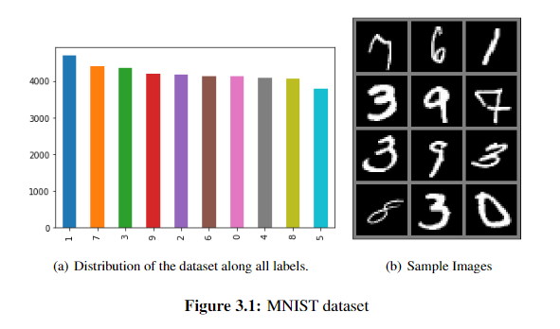
Methodology
Training Neural Network
Data Collection: For training, MNIST [7] was chosen which contains 60k training images and 10k test images of 28x28 size of handwritten digits from 0 to 9

Slide 11
Methodology…
Preprocessing Steps:
Grayscale Conversion: convert image to grayscale with 0 to 255 values.
Normalization: convert image pixel value to have a mean at 0.5.

Slide 12
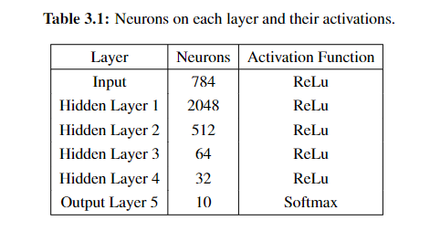
Methodology…
Defining the neural network
Initialize parameters with Kaiming He[8] initialization.

Slide 13
Methodology…
Training the dense network:
Epochs: 10
Learning rate : 0.009
Momentum = 0.93
Dampening = 0.05
Weight decay = 0.009
Optimizer = SGD

Slide 14
Methodology…
Pruning the network
The FCNN is initialized with some parameters with He initialization w0 ∼ Dw0. The initialization should be equal to the original dense networks initialization.
The network is trained with SGD with a learning rate of 0.009 and the network parameters was pruned by (p + 1)% at pth iteration. While the output layer parameters were pruned by 1/4%. A binary mask is obtained of the pruned network. Here, the absolute values of parameters are sorted in ascending order and then pruned by removing (p + 1)% of the parameters from the smallest value.
After pruning the network, the network’s parameters were reinitialized to the w0 and the mask is applied to the network that was obtained after pruning (p + 1)% network in Step 2.
Repeat from Step 1.

Slide 15
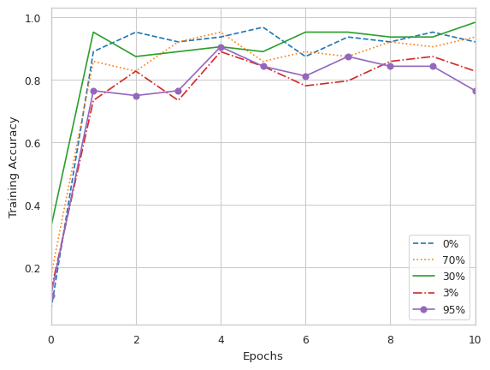
Results and Conclusion
Results
The training accuracy of the models with
about 30% is actually better than the original
network.
While, after pruning 95% the model does not
seem to learn at all.

Slide 16
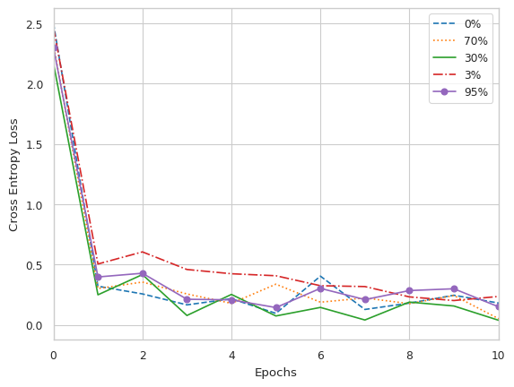
Results and Conclusion…

Slide 17
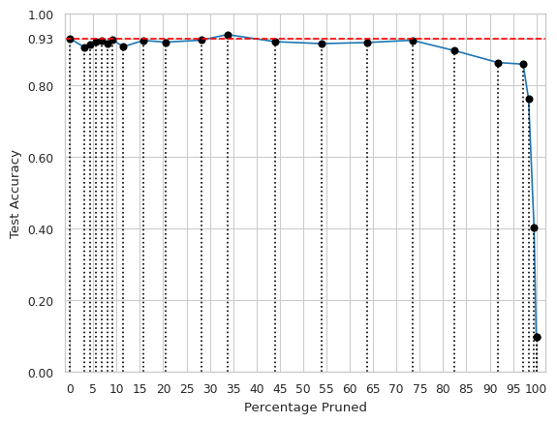
Results and Conclusion…
The test accuracy of around 33% of pruned network shows the best results.
It can also be seen that pruning about 75% percent of the model parameters essentially does not hurt the test accuracy that much. But after that the test accuracy drastically decreases.

Slide 18
Results and Conclusion…
Conclusion
So, it can be seen that after pruning the model by 30% of the models parameters, it surpasses the test accuracy of the original model and can maintain its accuracy similar to original network even after high levels of pruning.
It also proves the Lottery Ticket Hypothesis by showing an existence of a subnetwork that performs just as well as the original network.

Slide 19
References
[1] J. Frankle and M. Carbin, The lottery ticket hypothesis: Finding sparse, trainable neural networks, 2019. arXiv: 1803.03635 [cs.LG].
[2] Y. L. Cun, J. S. Denker, and S. A. Solla, “Optimal brain damage,” in Advances in Neural Information Processing Systems 2. San Francisco, CA, USA: Morgan Kaufmann Publishers Inc., 1990, pp. 598–605, ISBN: 1558601007.
[3] H. Cheng, M. Zhang, and J. Q. Shi, A survey on deep neural network pruning-taxonomy, comparison, analysis, and recommendations, 2023. arXiv: 2308.06767 [cs.LG].
[4] S. Han, H. Mao, and W. J. Dally, Deep compression: Compressing deep neural networks with pruning, trained quantization and huffman coding, 2016. arXiv: 1510.00149 [cs.CV].
[5] P. Savarese, H. Silva, and M. Maire, Winning the lottery with continuous sparsification, 2021. arXiv: 1912.04427 [cs.LG].
[6] J. Diffenderfer and B. Kailkhura, Multi-prize lottery ticket hypothesis: Finding accurate binary neural networks by pruning a randomly weighted network, 2021. arXiv:2103.09377 [cs.LG].
[7] Y. LeCun and C. Cortes, “MNIST handwritten digit database,” 2010. [Online]. Available: http://yann.lecun.com/exdb/mnist/.
[8] K. He, X. Zhang, S. Ren, and J. Sun, Delving deep into rectifiers: Surpassing human-level performance on imagenet classification, 2015. arXiv: 1502.01852 [cs.CV].

